Slide 1
Harrow Lodge Primary School
Teaching Relationships and Sex Education (RSE) to your children.

Slide 2
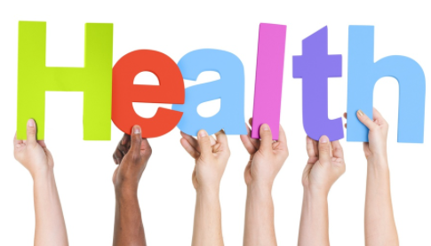
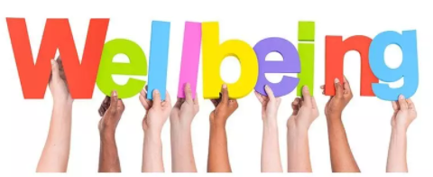
Relationships and Sex Education
Pupils should be taught:
  ways of keeping physically and emotionally safe
  about managing change, such as with puberty and transition
  how to make informed choices about health and well-being and to recognise sources of help with this

Slide 3
When is Relationships and Sex Education taught?
-Most lessons take place throughout June and July.
-One lesson a week is usually taught or teachers may block some lessons together to teach two or three lessons in the same week.
-Lessons linked to appropriate touches are generally referred to on a day-to-day basis throughout the whole school year as well as in discrete lessons taught.
-Lessons linked to Knife Crime in Years 5 and 6 take place towards the end of May/start of June.

Slide 4
What is statutory?
Key Areas:
  Science
  Relationships Education
  Health Education
  Safeguarding
  *The only sessions that children can be withdrawn from are those related to conception.

Slide 5
EYFS

Slide 6
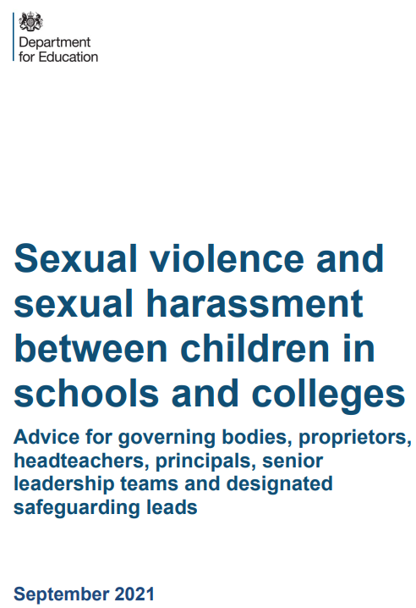
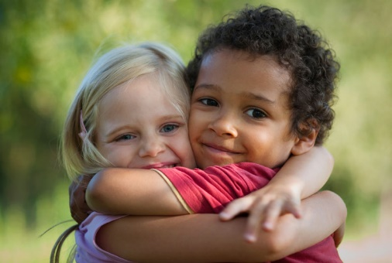
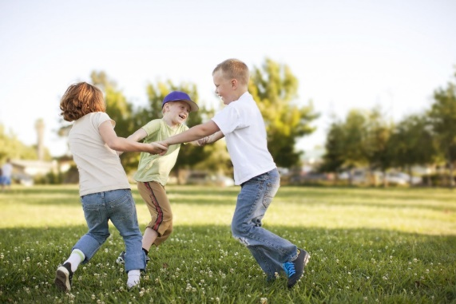
EYFS – Appropriate touch with my friends
-links to NSPCC’s Pantosaurus – public/private parts
-knowing what good touches are and where I can touch my friends appropriately
-knowing a trusted adult to turn to
*DfE publication
*Safeguarding
*Relationships Education

Slide 7
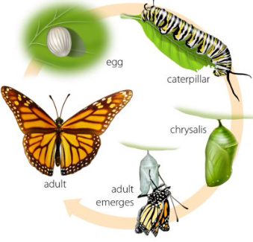
EYFS – Life Cycles
-understanding the order and processes of different life cycles
-understanding that changes happen as we grow that are natural and OK
*No mention of conception/how a baby comes to be

Slide 8
Year 1

Slide 9
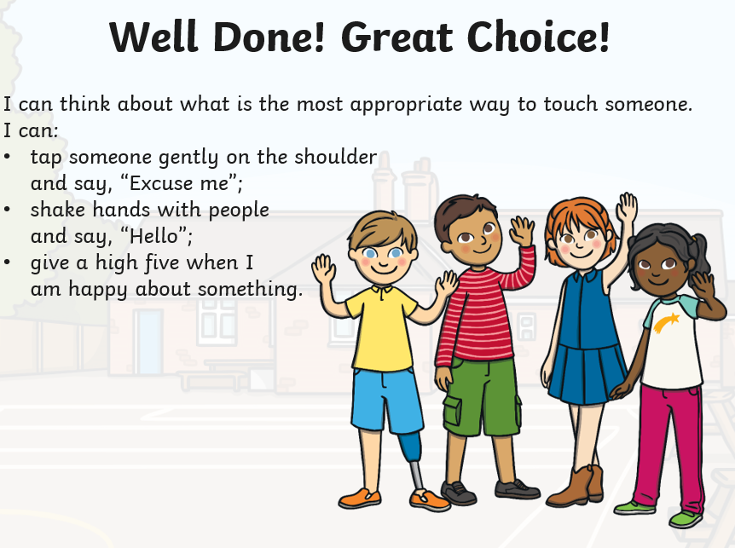
Year 1 – Appropriate physical contact with my friends
-links to NSPCC’s Pantosaurus – public/private parts
-appropriate vs. inappropriate touches, e.g. holding hands nicely vs. kissing someone’s arm
-knowing a trusted adult to turn to
*DfE publication
*Safeguarding
*Relationships Education

Slide 10
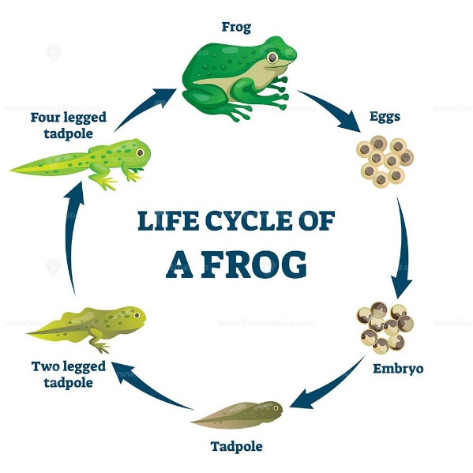
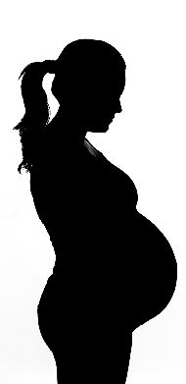
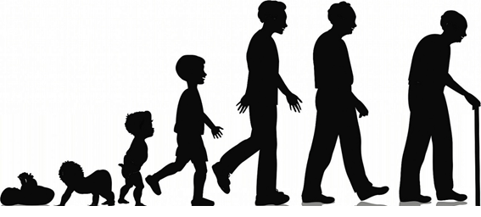
Year 1 – Life Cycles
-delving further into the order and processes of different life cycles
-understanding that changes happen as we grow that are natural and OK
-initial thoughts, feelings and emotions about change
*No mention of conception/how a baby comes to be

Slide 11
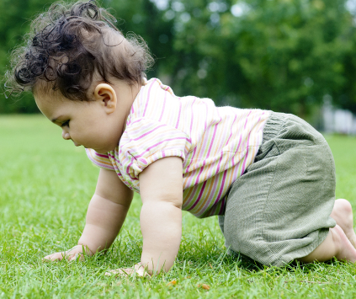
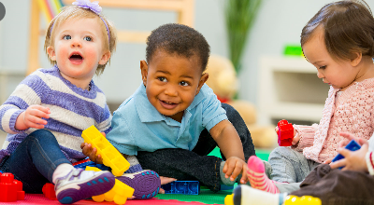
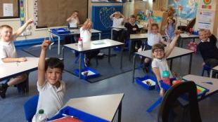
Year 1 – Body Changes
-understanding similarities and differences in how children look now compared to when they were babies/toddlers
-understanding similarities and differences in what the children can do now compared to when they were babies/toddlers
-knowing that I change a little bit every time I learn something new

Slide 12
Year 2

Slide 13
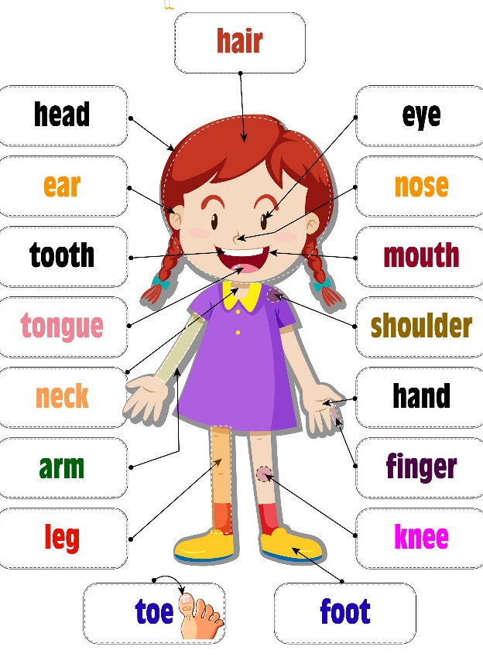
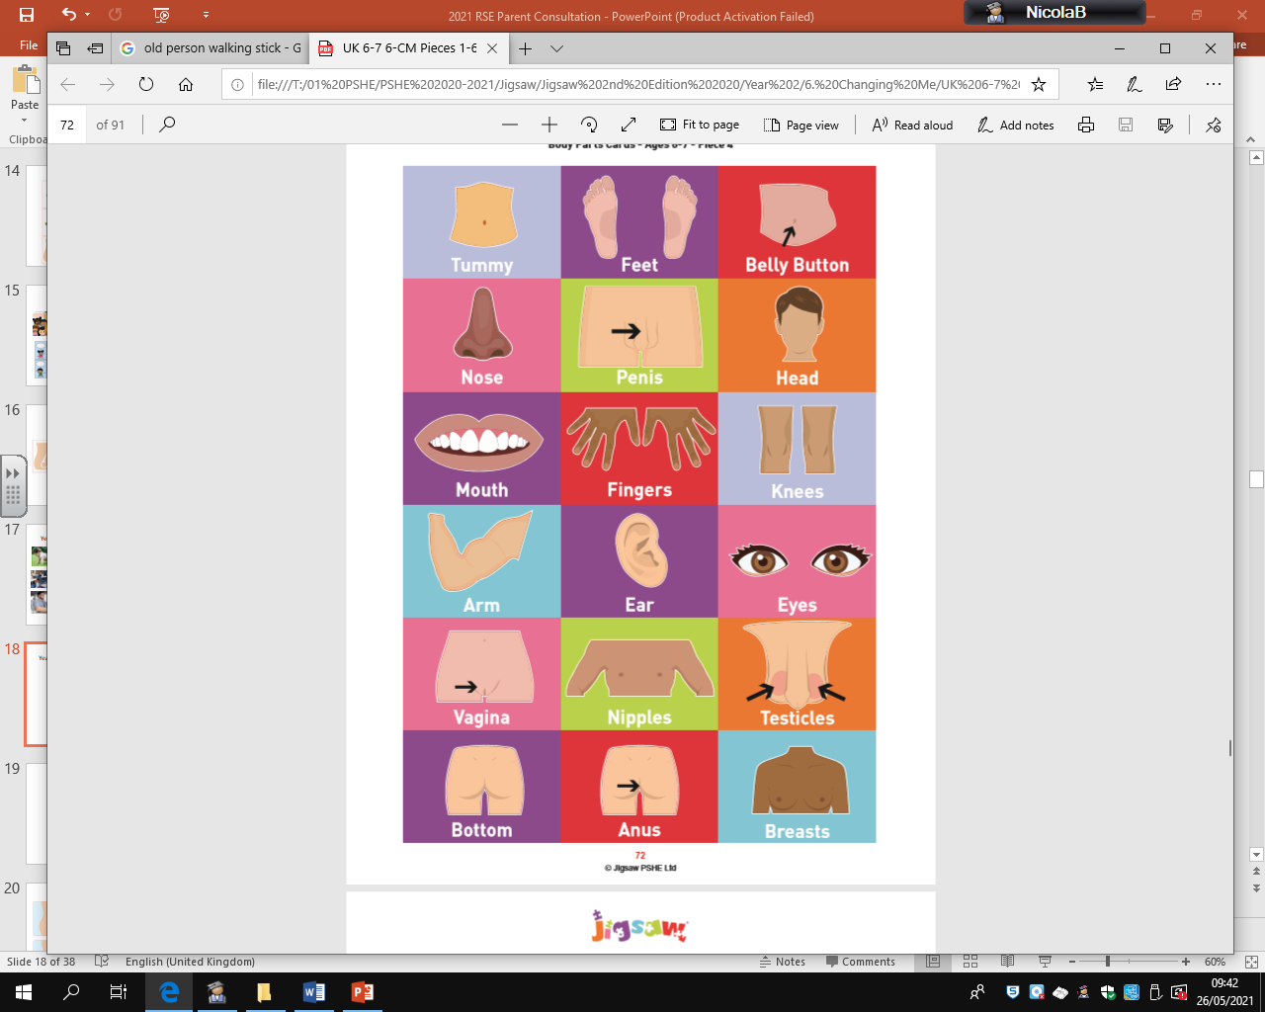
Year 2 – Male and Female Body Parts
-recognising physical differences between boys and girls
-using the correct names for body parts
-knowing which parts of our bodies are private
*This is statutory learning for Science.

Slide 14
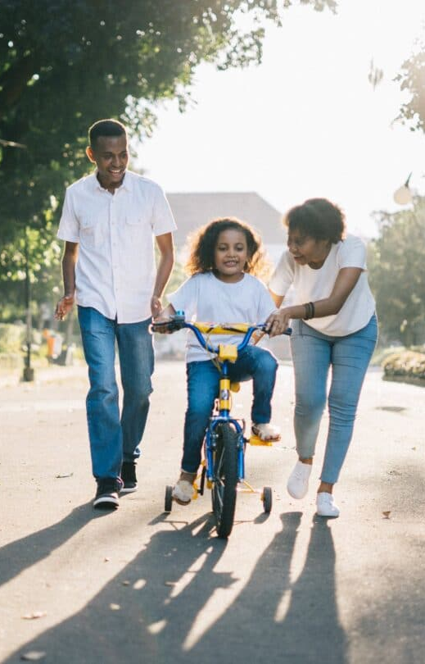
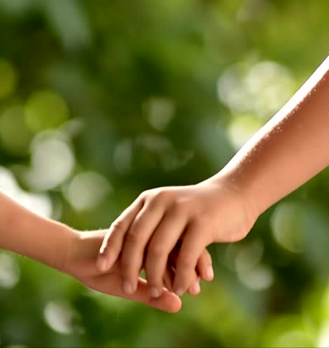
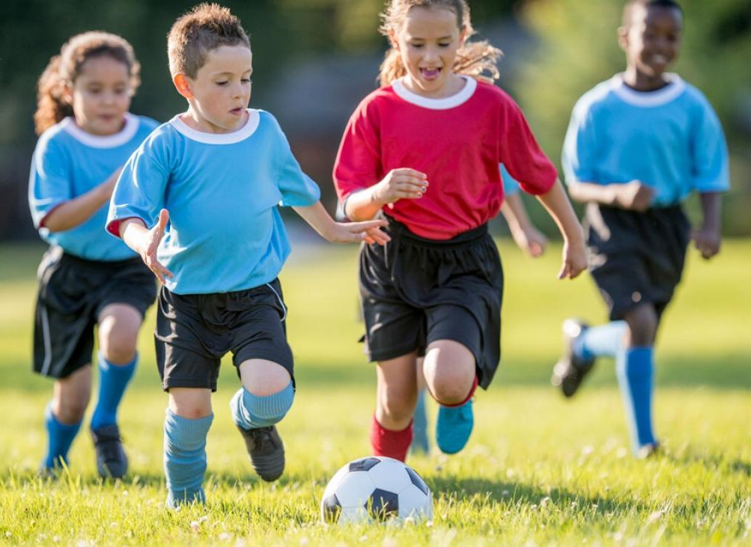
Year 2 – Understanding different forms of appropriate contact with my friends and family
-links to NSPCC’s Pantosaurus – public/private parts
-touches we like, e.g. a handshake, a hug, holding hands
-touches we do not like, e.g. pushing, shoving, a smack on the bottom in a game
-knowing a trusted adults to turn to
*DfE publication *Safeguarding *Relationships Education

Slide 15
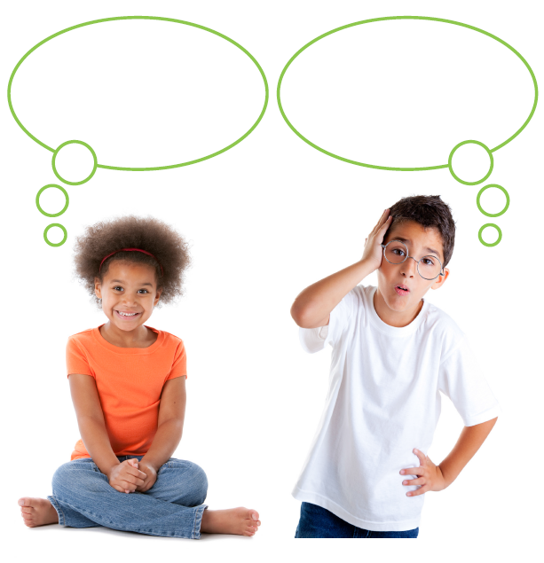
Year 2 – Good secrets vs. worry secrets
-good secrets, e.g. keeping a birthday surprise a secret
-worry secrets, e.g. witnessing a bully hurting your friend and being told not to tell
-knowing a trusted adult to turn to
*Safeguarding

Slide 16
Year 2 – Cycles of life in nature
-recapping the order and process of different life cycles
-focusing on how the children feel about change and thinking about the positive aspects of change rather than the fear of it
*No mention of conception/how a baby comes to be
*This is statutory learning for Science.

Slide 17
Year 3

Slide 18
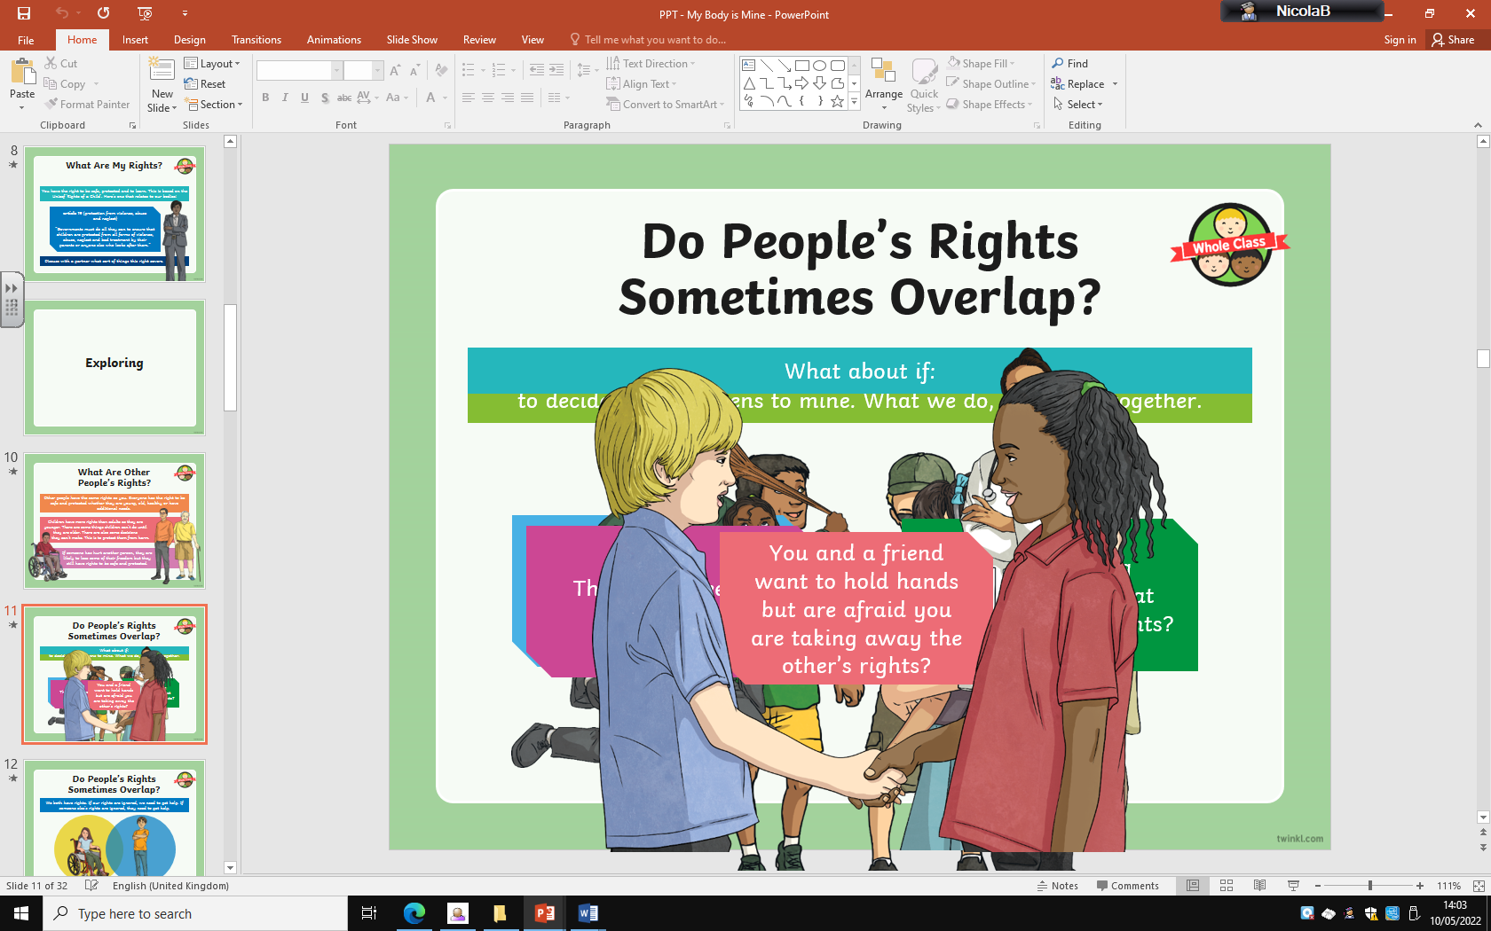
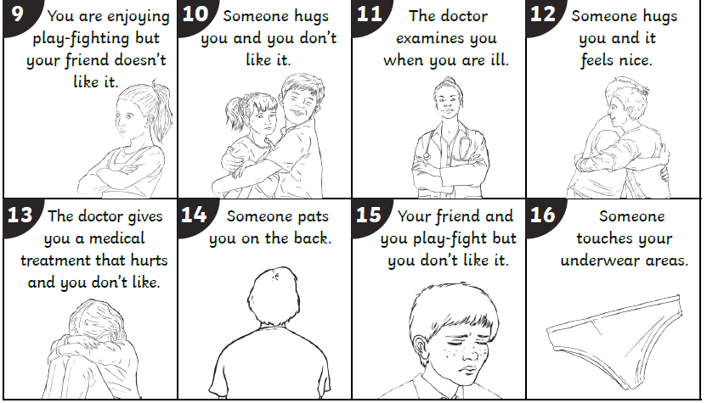
Year 3 – acceptable and unacceptable physical contact with my friends
-links to NSPCC’s Pantosaurus – public/private parts
-rights of the child
-appropriate and inappropriate physical contact/blurred boundaries
-knowing a trusted adults to turn to
*DfE publication
*Safeguarding
*Relationships Education

Slide 19

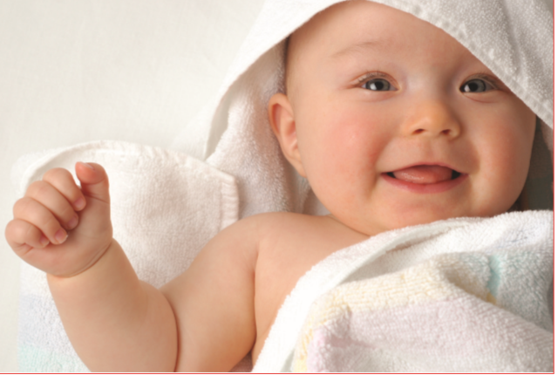
Year 3 – A baby’s needs
-understanding what a baby needs to survive in the womb
-knowing what a baby needs to live and grow when it is born, e.g. food, love, protection
*No mention of conception/how a baby comes to be
*This is statutory learning for Science.
*Safeguarding

Slide 20
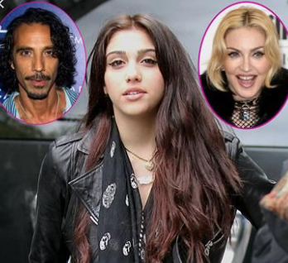
Year 3 – Inherited Characteristics
-understanding my own, and others’, inherited characteristics
-appreciating that everyone is unique in their own ways
*No mention of conception/how a human comes to be

Slide 21
Year 3 – Body Changes on the Outside (external puberty)
-understanding changes that will happen gradually with our bodies as we go from being children to adults
-understanding how boys’ and girls’ bodies change on the outside during the growing up process
-identifying similarities and differences between boys and girls
*Health Education - puberty
*Safeguarding/sensitive
*No mention of how puberty relates to conception

Slide 22
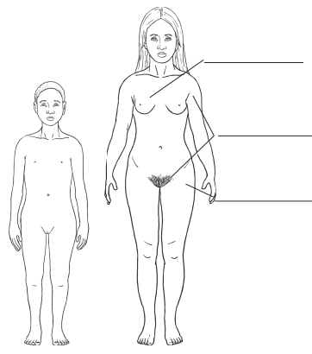
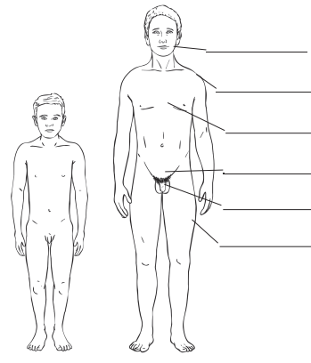
Year 3 – Body Changes on the Outside
“Hair will grow under my arms.”
“My voice will get deeper.”
“My hips will widen.”
“My penis and testicles will grow larger.”
“My breasts will grow.”
“Hair will grow on my legs.”

Slide 23
Year 4

Slide 24
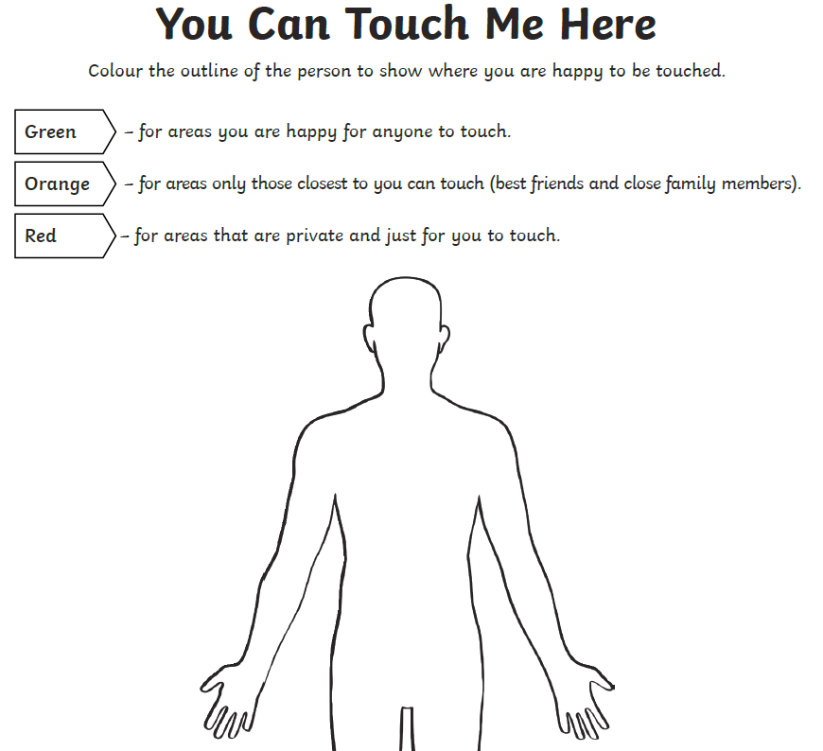
Year 4 – Acceptable and unacceptable physical contact with my friends
-links to NSPCC’s Pantosaurus – public/private parts
-rights of the child/blurred boundaries
-outlining where I am happy to be touched
-knowing a trusted adults to turn to
*DfE publication
*Safeguarding

Slide 25
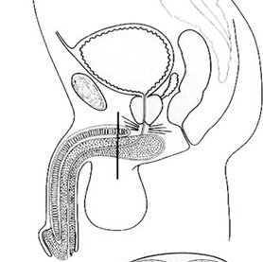
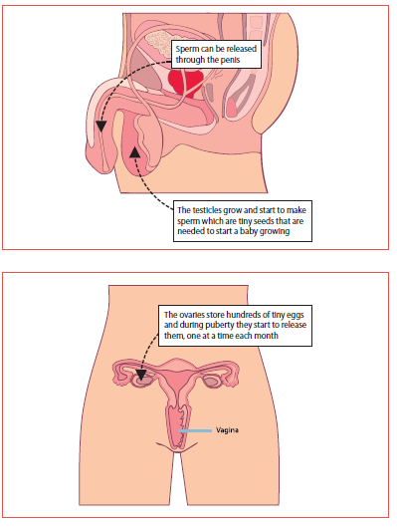
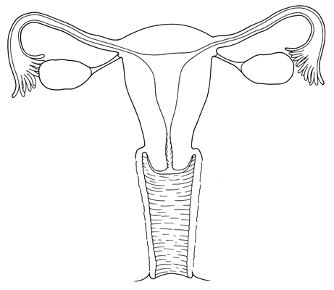
Year 4 – Labelling external and internal parts of male and female bodies
-recapping external puberty that has been previously taught
-understanding how bodies change during the growing up process
-recognising how I feel about changes
-Key Vocab: puberty, penis, testicles, sperm, urethra, vagina, ovaries, egg, womb/uterus, fallopian tube
The testicles grow and start to make sperm which are tiny seeds.
*Science
*No mention of conception/how a baby comes to be

Slide 26
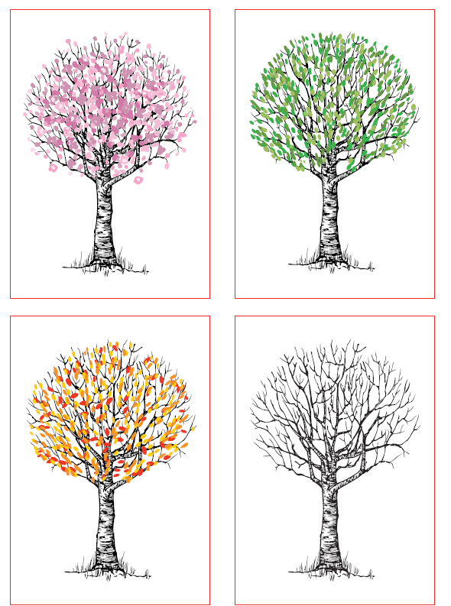
Year 4 – Other changes outside of my control
-changes in life, e.g. parents splitting up, a friend moving away etc.
-expressing fears and concerns and knowing how to manage these feelings positively
*Safeguarding/personal backgrounds and lives

Slide 27
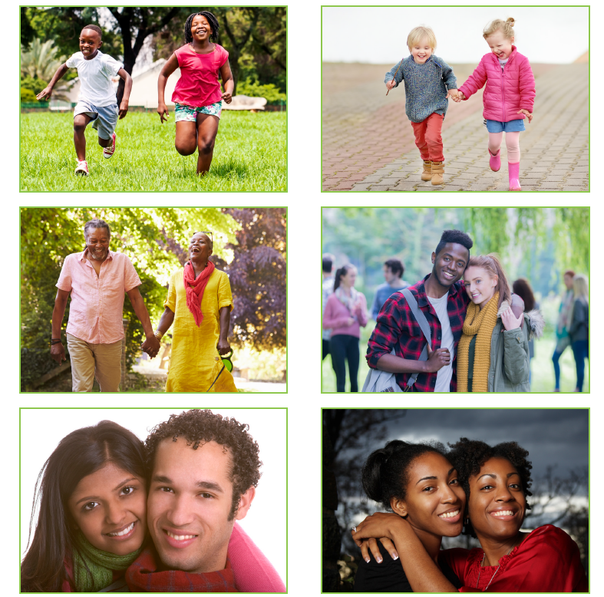
Year 4 – Romantic Relationships
-understand what it might mean and that it’s a special relationship for when you are older
-peer-pressure
*Safeguarding

Slide 28
Year 5

Slide 29
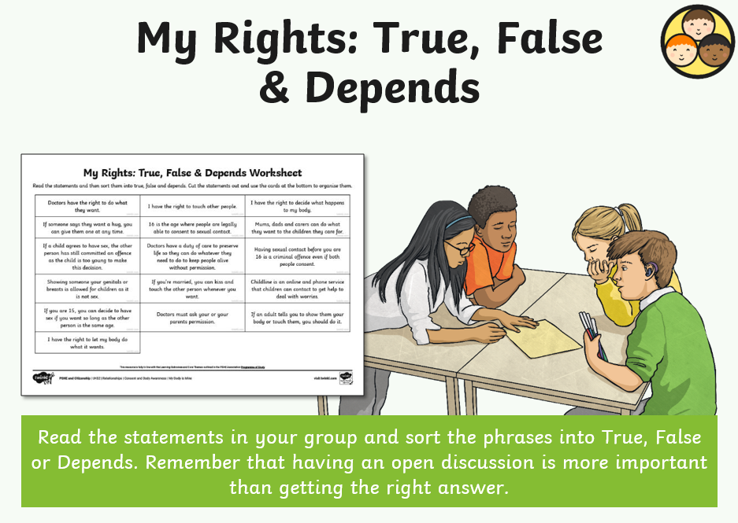
Year 5 – acceptable and unacceptable physical contact with my friends
-links to NSPCC’s Pantosaurus – public/private parts
-expressing opinions/debate
-ways of dealing with a range of issues
-knowing a trusted adults to turn to
*DfE publication
*Safeguarding

Slide 30

Year 5 – Positive and negative consequences when communicating with others online
*Relationships Education *Safeguarding
age restrictions
time spent online
pros and cons/risks of joining online groups
strangers online
cyber bullying

Slide 31

Year 5 – Knife Crime
*Relationships Education *Safeguarding
dangers and consequences of carrying knives
scenario/consequences
Ben Kinsella Trust

Slide 32
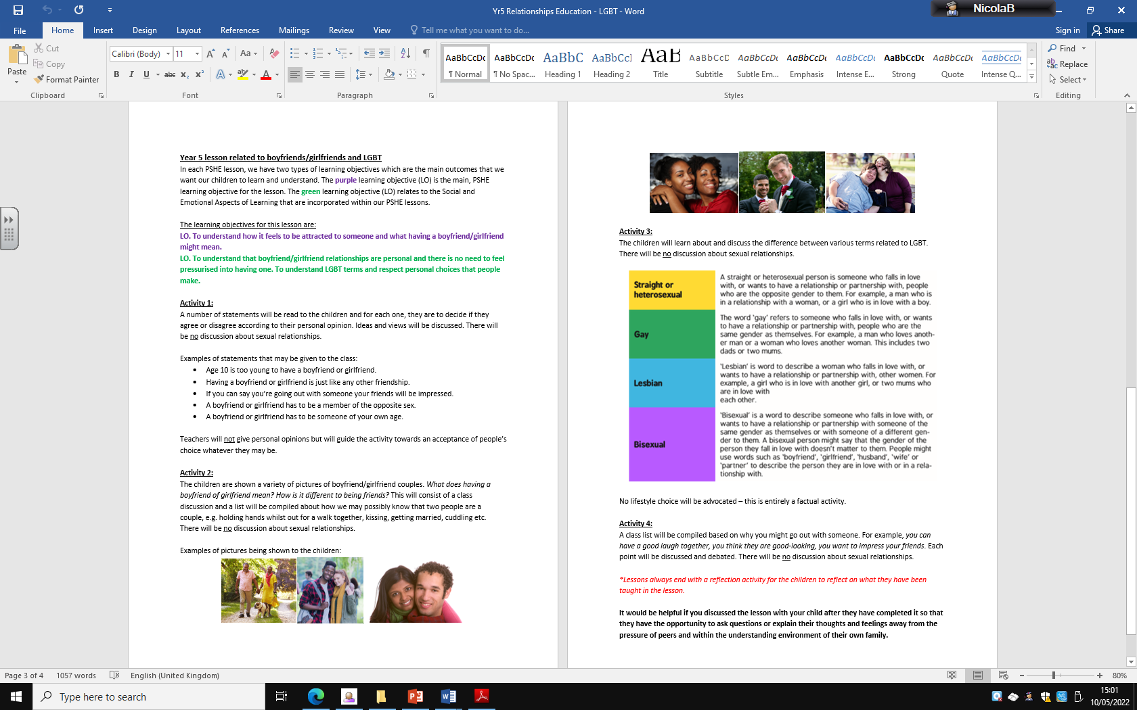
Year 5 – Romantic Relationships - LGBT references
*Relationships Education *Safeguarding

Slide 33
Year 5 – Female Body Changes during Puberty
*This lesson will be taught in single gender groups. Boys and girls will both learn about menstruation.
Understanding the process of menstruation. Knowing what happens if an egg is or is not fertilised.
Girls – Discussing how to use sanitary products for periods.
*We aim to invite the school nurse to these sessions.
*Health Education
*Safeguarding

Slide 34
Year 5 – Male Body Changes during Puberty
*This lesson will be taught in single gender groups. Girls and boys will both learn about this.
Understanding how boys’ bodies change during puberty.
*This is statutory learning for Health Education related to puberty.

Slide 35
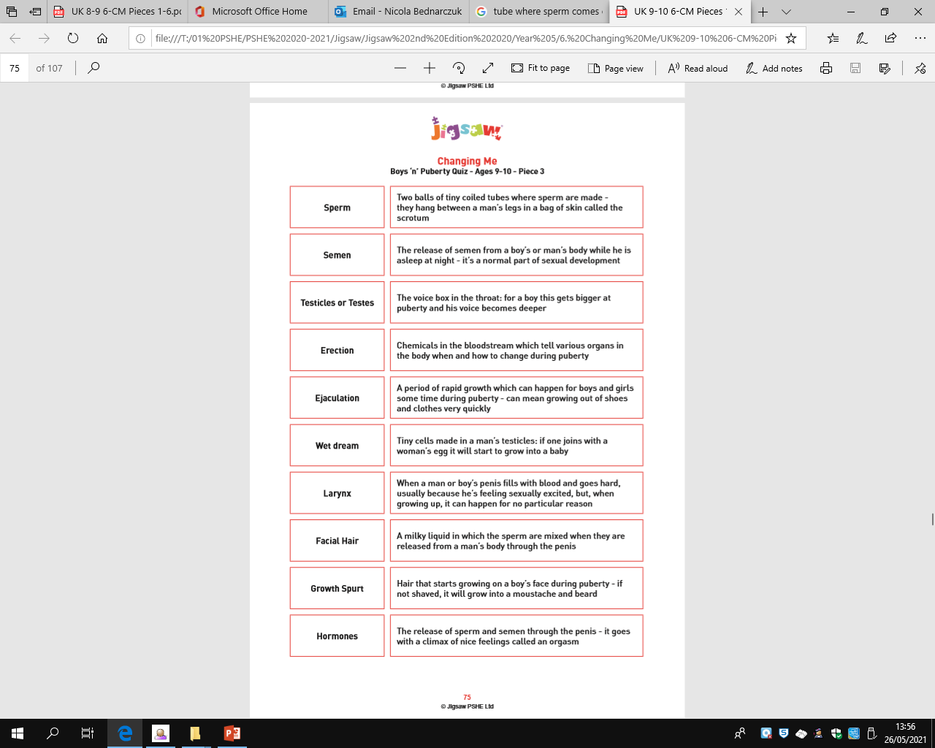
Year 5 – Male Body Changes during Puberty
*All keys terms are explained factually.
*There is no reference to sexual pleasure.
*A ‘wet dream’ is described as sperm that can leak out.

Slide 36
Year 5 – The process of how things are made/
*Conception
*This is the only lesson in Year 5 from which you may withdraw your child due to religious reasons or other reasons. Please arrange a meeting with Mrs Searle if you wish to exercise this right.

Slide 37
Year 6

Slide 38
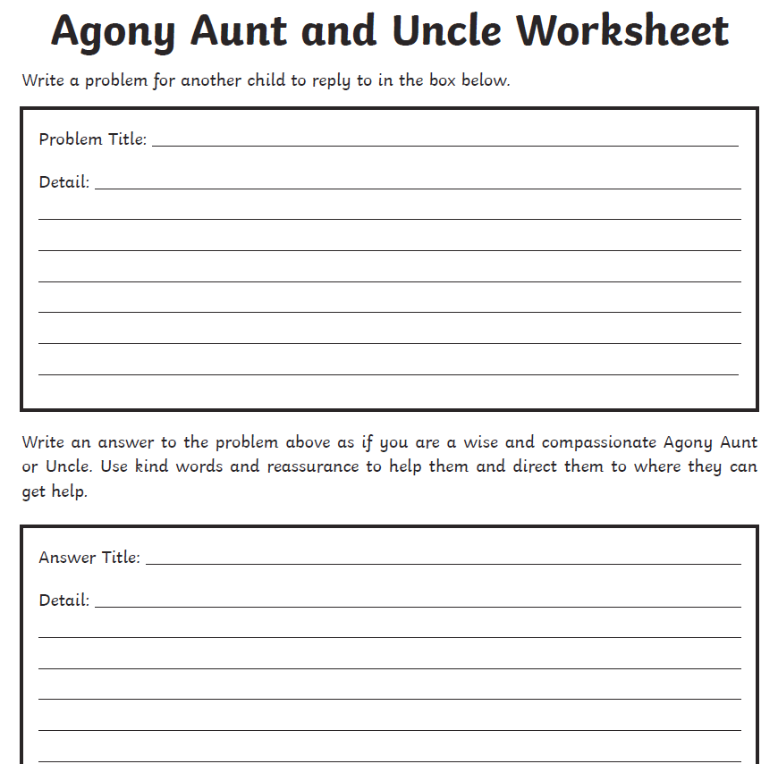
Year 6 – acceptable and unacceptable physical contact with my friends
-links to NSPCC’s Pantosaurus – public/private parts
-expressing opinions/debate
-ways of dealing with a range of issues
-knowing a trusted adults to turn to
*DfE publication
*Safeguarding

Slide 39
Year 6 – Knife Crime
*Relationships Education *Safeguarding
dangers and consequences of carrying knives
scenario/consequences
Ben Kinsella Trust

Slide 40

Year 6 – Gangs
*Relationships Education *Safeguarding
appropriate gangs/groups, e.g. football gangs
inappropriate gangs, e.g. violence
exploitation
challenging stereotypes
peer-pressure

Slide 41
Year 6 – Puberty Continued
*Health Education *Safeguarding
recapping puberty from Year 5
facts vs. myths
thoughts, feelings and emotions
“If you get spots during puberty it’s because you have a bad diet.”
“A girl should avoid having baths when she has a period.”
“Girls get hairy legs, just like boys do.”
“My penis and testicles will grow larger.”
“Most boys have wet dreams at some point during puberty.”

Slide 42
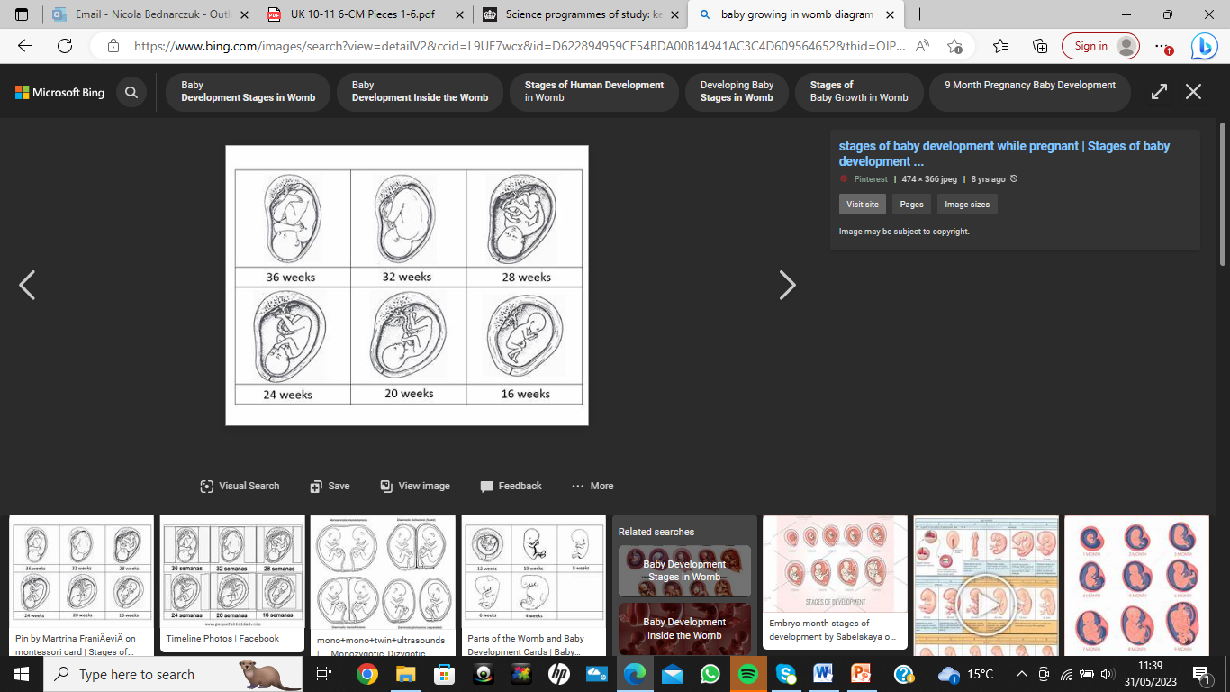
Year 6 – Conception and Giving Birth
*Health Education *Safeguarding
journey from conception to birth
thoughts, feelings and emotions linked to giving birth
responsibilities
*This is the only lesson in Year 6 from which you may withdraw your child due to religious reasons or other reasons. Please arrange a meeting with Mrs Searle if you wish to exercise this right.

Slide 43
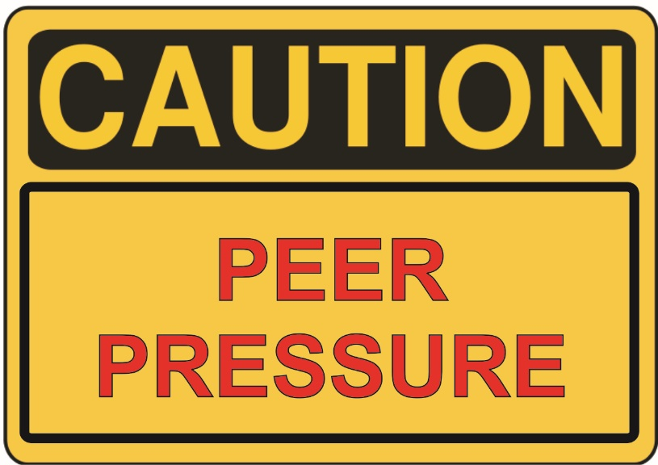
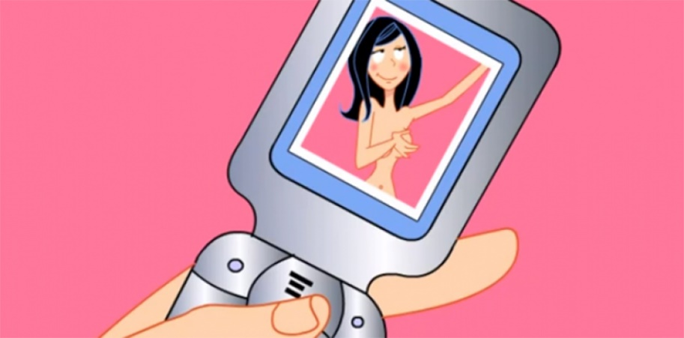
Year 6 – Romantic Relationships
*Health Education *Safeguarding
recapping LGBT
sexting
not feeling pressured to do anything that you do not want to do

Slide 44

Thank you. ☺
Any questions?
Please get in touch with Mrs Searle or Miss B (RSE/PSHE Lead).

